Slide 1

About Tcpdump
Process
Flowchart
Key Features
Tcpdump tool

Slide 2
About Tcpdump :
The main purpose of the powerful command line network analysis program tcpdump is to record, examine and troubleshooting network packets. By intercepting and showing packet contents as they pass through network interfaces, it offers insights into network traffic.
Standards

Slide 3
Process
Step 1: Select Network Interface • Choose the network interface you wish to monitor.
Example: eth0, wlan0
Step 2: Enter Host/IP Address (Optional) • Specify a specific host/IP to filter traffic.
Example: 192.168.1.5 (leave empty for all traffic)
Step 3: Specify Port (Optional) • Filter traffic by port number.
Example: 80 (HTTP), 443 (HTTPS) (leave empty for all ports)
Step 4: Select Protocol (Optional)
• Choose a specific protocol to filter packets.
TCP, UDP, ICMP (or leave empty to capture all protocols)
Click on the model to interact

Slide 4
2. Relation between Earth, Sun, and Moon
Step 5: Start Capture
• Click Capture to begin packet collection.
Step 6: View and Analyze Output
• Captured packet data is displayed clearly for immediate analysis.
Let's look at an output example:
• tcpdump -i eth0 host 192.168.1.5 and port 80 -vv
Now lets breakdown the command-
• -i eth0: Specifies capturing packets on the eth0 network interface.
• host 192.168.1.5: Filters the captured network traffic to include only packets sent to or received from the specified IP address (192.168.1.5).
• port 80: Further narrows the captured traffic to only those packets involving port 80, typically associated with HTTP traffic.
• -vv: Produces highly detailed (verbose) output, providing comprehensive information about each captured packet.

Slide 5
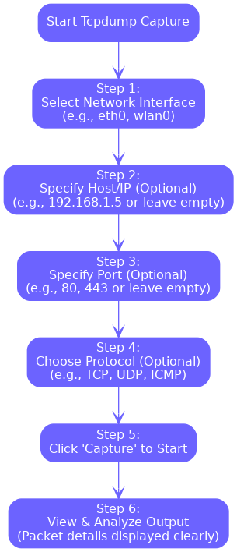
Flowchart

Slide 6
Key Features
• Packet Capture:
Records network traffic by intercepting data packets transmitted across networks.
• Packet Analysis:
Offers comprehensive insights into captured packets, detailing their contents and network behavior.
• Advanced Filtering:
Enables precise filtering of network traffic through customizable filter expressions.
• Protocol Inspection:
Capable of analyzing diverse protocols, including TCP, UDP, ICMP, among others.
• Data Management:
Facilitates saving captured packet data into files for convenient later review and analysis.

